Slide 1
Traditional Marketing Vs Digital Marketing
Learning Outcome
To differentiate the digital marketing from traditional marketing by understanding the connotation of digital marketing

Slide 2
Digital Marketing Overview
What does digital marketing consist of?
Digital Marketing is the process of MARKETING of Products and services by using internet and digital devices like computers, tablets, mobile phones etc
What is Digital Marketing

Slide 3

Traditional Marketing
Traditional marketing concept focuses on products only and it aims in production and marketing of products and gaining more profit. ...
It is one dimensional as the only target of it is to sell the product and get the profit.
What is Traditional Marketing

Slide 4
Traditional Marketing Vs Digital Marketing
1. Wide Reach
2. Niche Marketing
3. Cost Effective
4. Measurement and Tracking
5. Generates Potential Leads
6. Performance Oriented
7. Real Time Results
8. Audience Control
9. Interactivity
10.Fair Play/Equity
Class-I
Class-II
Class-III

Slide 5
Traditional Marketing Vs Digital Marketing
1. Wide Reach
2. Niche Marketing
3. Cost Effective
4. Measurement and Tracking
5. Generates Potential Leads
6. Performance Oriented
7. Real Time Results
8. Audience Control
9. Interactivity
10.Fair Play/Equity
Class-I
Class-II
Class-III

Slide 6
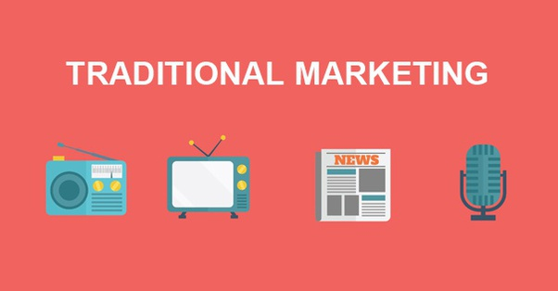
Wide Reach
Traditional Marketing
Limited Reach

Slide 7
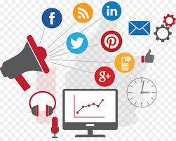
Wide Reach
Digital Marketing
Bigger Reach
50%
World population Internet
Source: Internet World Stats,2018

Slide 8
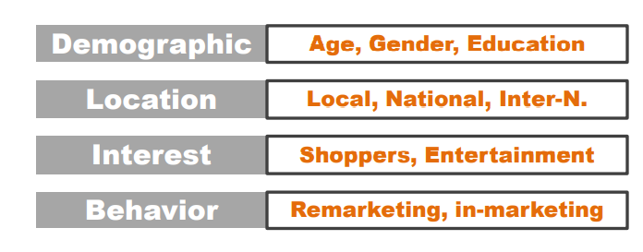
Niche Marketing
Traditional marketing doesn’t provide such control

Slide 9
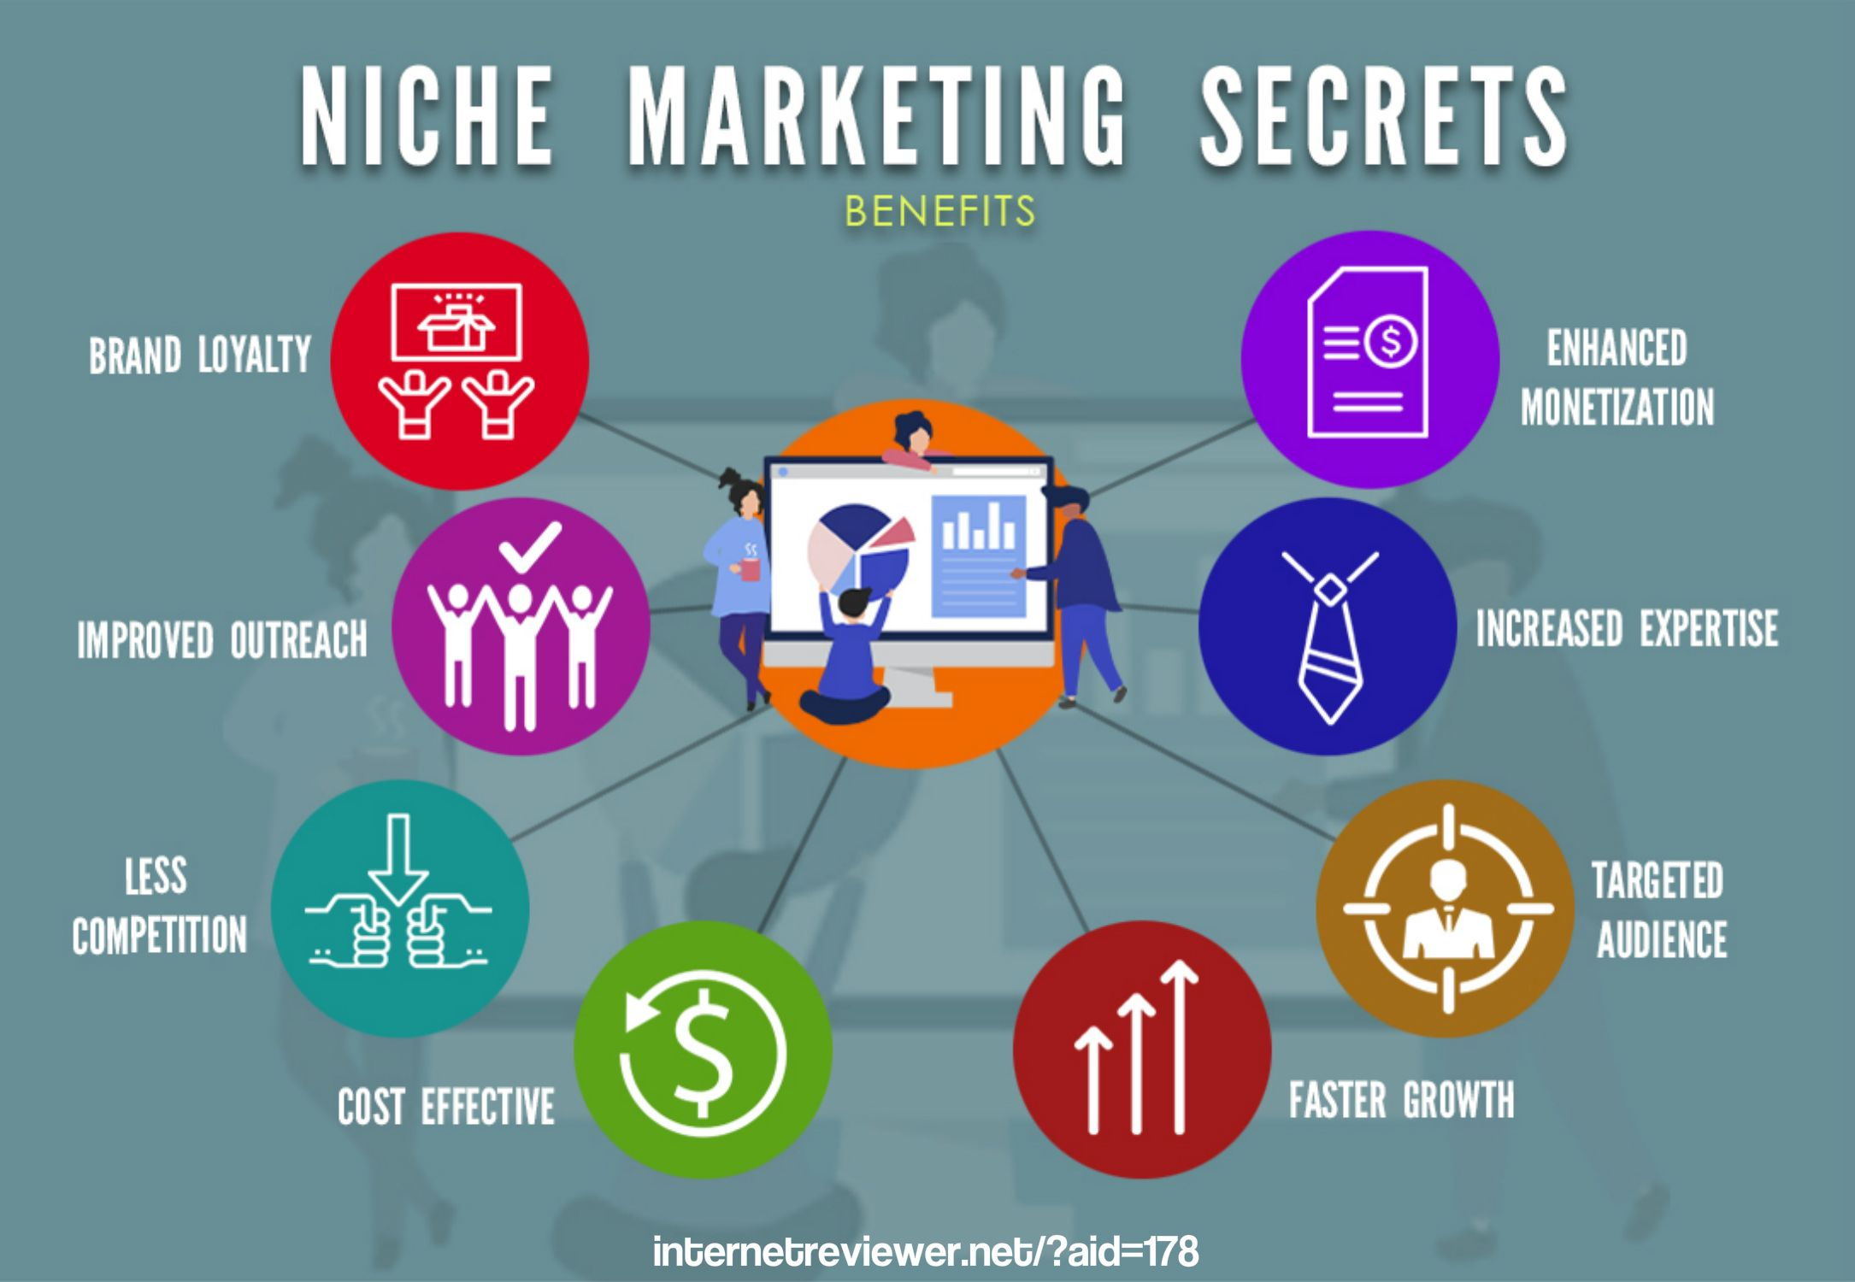
Niche Marketing
Benefits

Slide 10
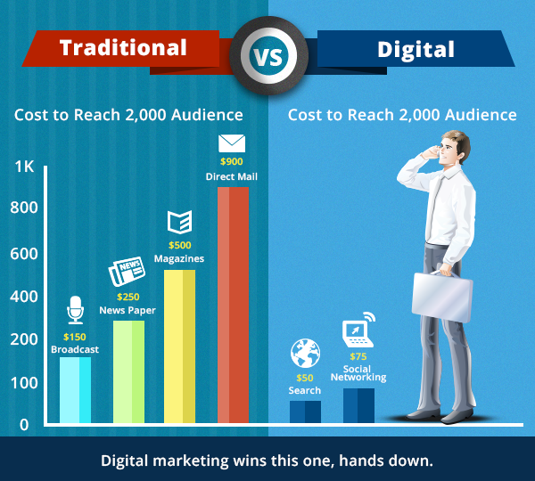
Cost Effectiveness
Digital Marketing much more cost effective as compared to traditional marketing

Slide 11
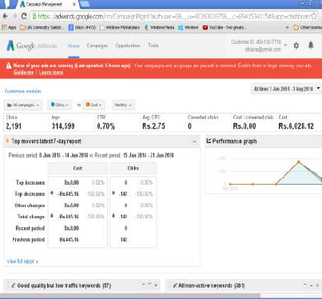
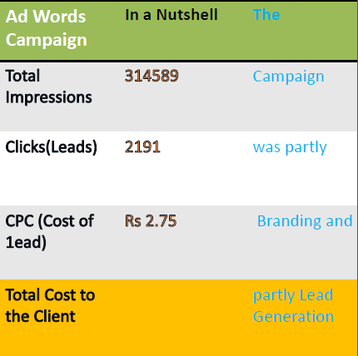
Traditional Vs Digital

Slide 12

Digital Marketing-Examples
Youtube

Slide 13
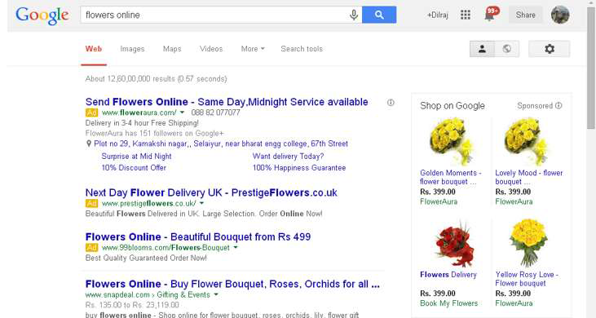
Digital Marketing-Examples
Text and Image

Slide 14
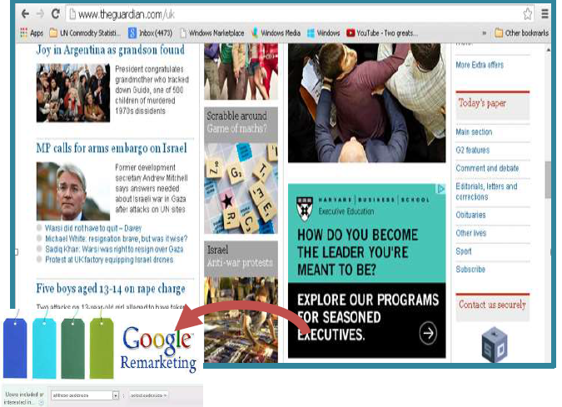
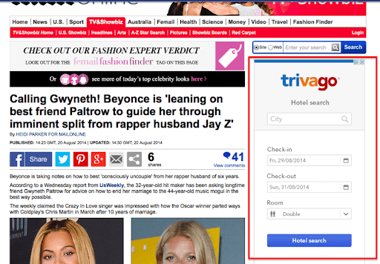
Digital Marketing
Google Remarketing

Slide 15
Video
Online Marketing Vs Traditional Marketing - YouTube

